Slide 1
Empirical noise distribution models for high contrast direct imaging
Dominic Sanchez
University of Arizona, Undergraduate
Mentor: Dr. Jordan Stone

Slide 2
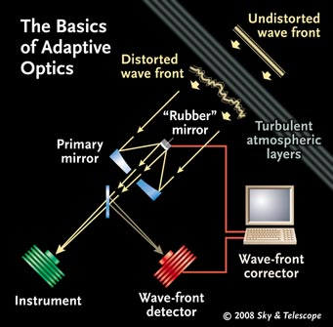
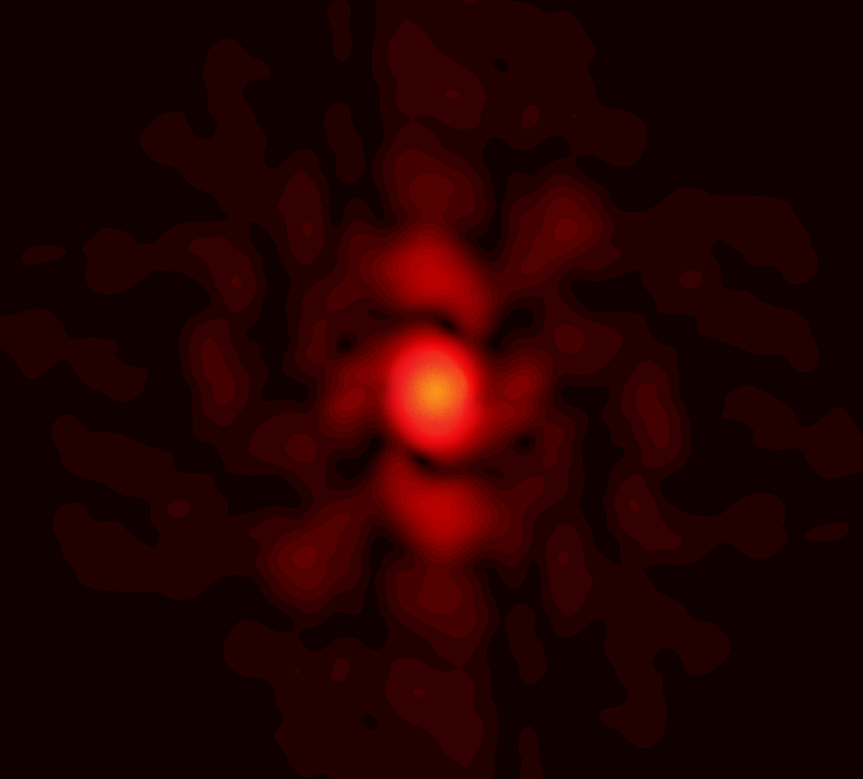
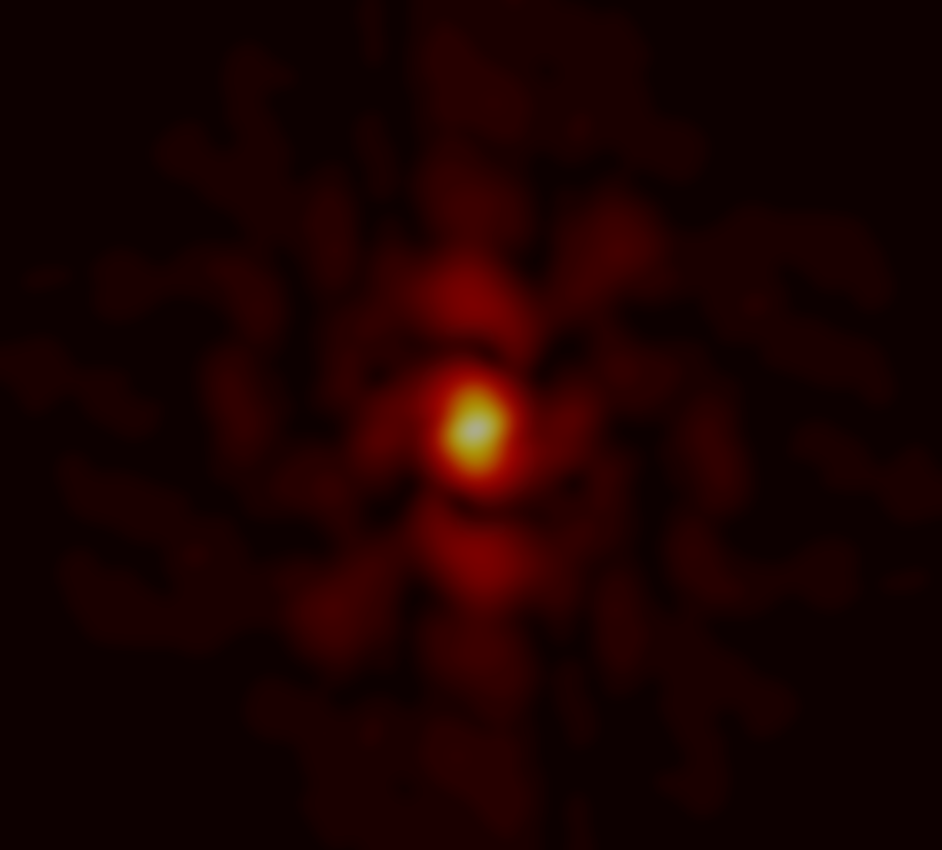
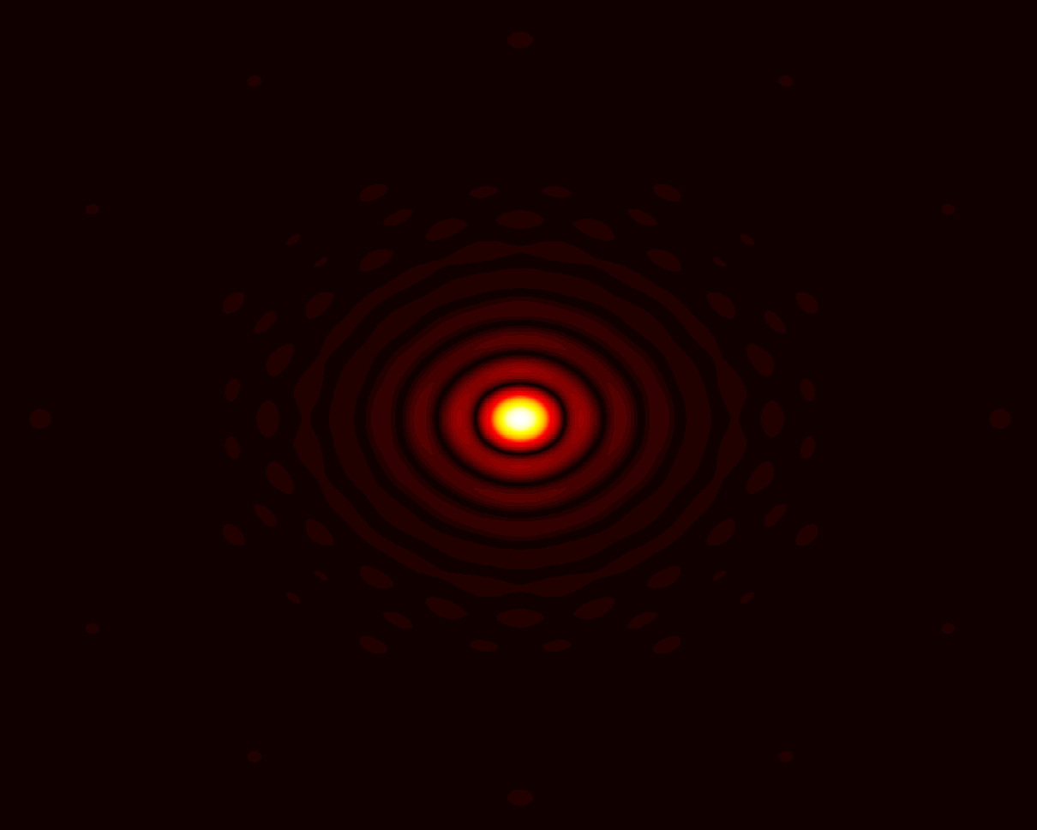
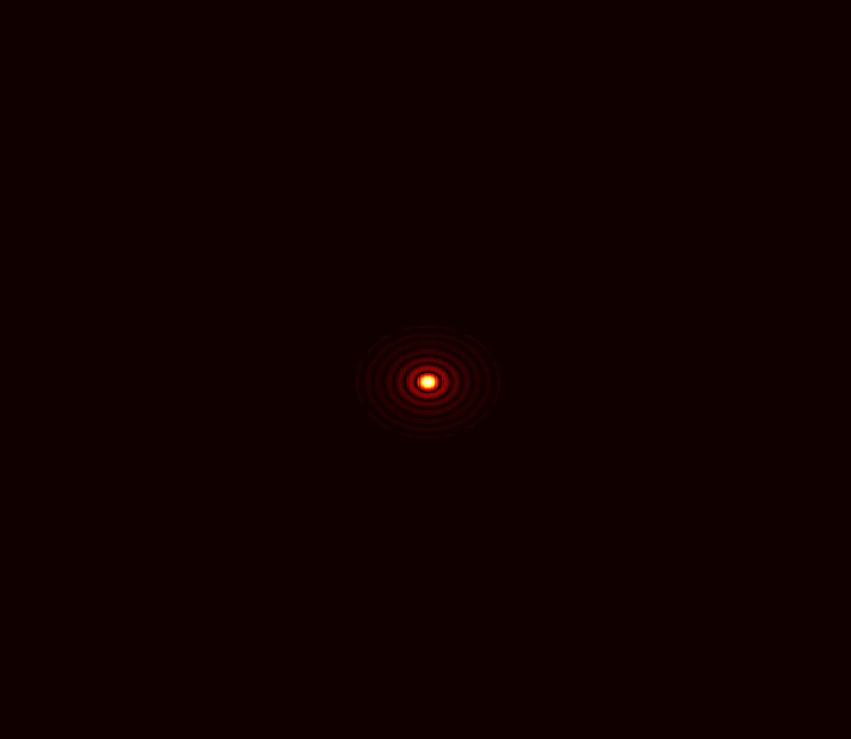
Background
Adaptive optics (AO) is a technology that measures and corrects wavefront errors
Restores image quality by correcting errors caused by the atmosphere
Wavefront error correction allows for higher resolution
Necessary for exoplanet direct imaging

Slide 3
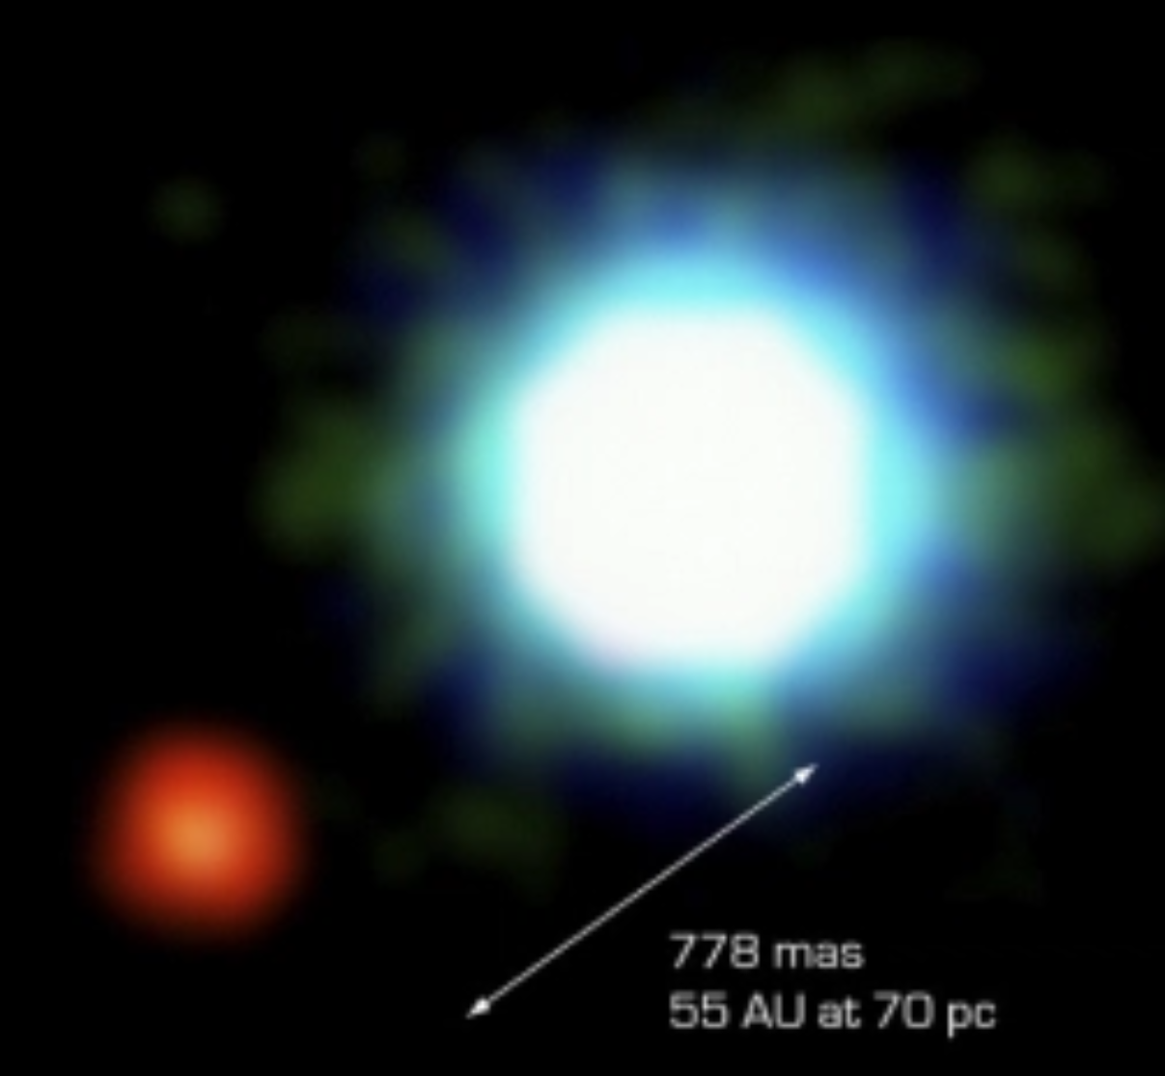
Directing Imaging
Starlight illuminates planets which allows for direct imaging
Yields information about exoplanet orbit, size, temperature, surface properties etc.
Difficult:
  Planets are dim
  Noise can “wash out” planet signal
Credit: Hatzes et al., 2003

Slide 4
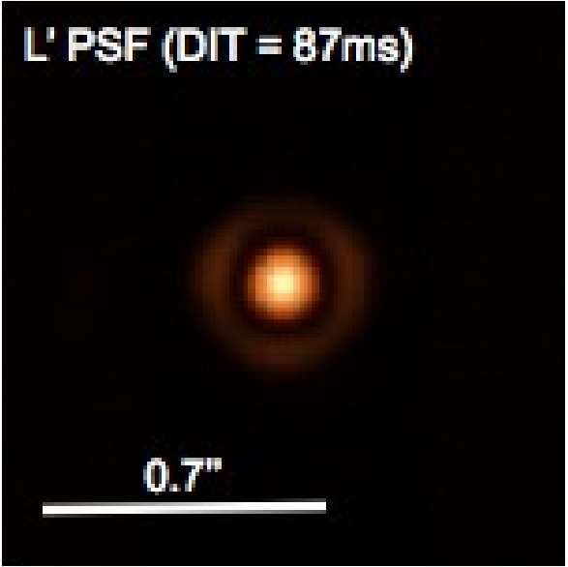
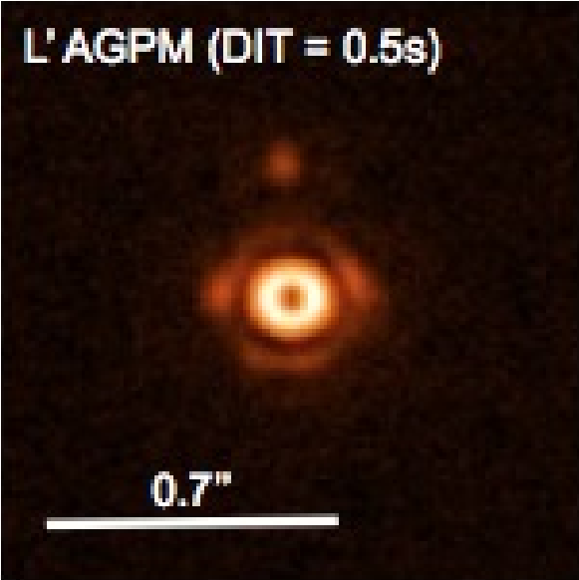
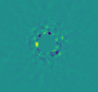
Noise
Photon noise
  Random fluctuation of photons
Speckle Noise
  Random irradiance pattern from mutual interference
Difficult to discern exoplanet signals
Coronagraph used to limit photon noise in some systems
Credit: D. Defrère, O. Absil, P. Hinz, J. Kuhn, D. Mawet, et al.
Exoplanet?

Slide 5
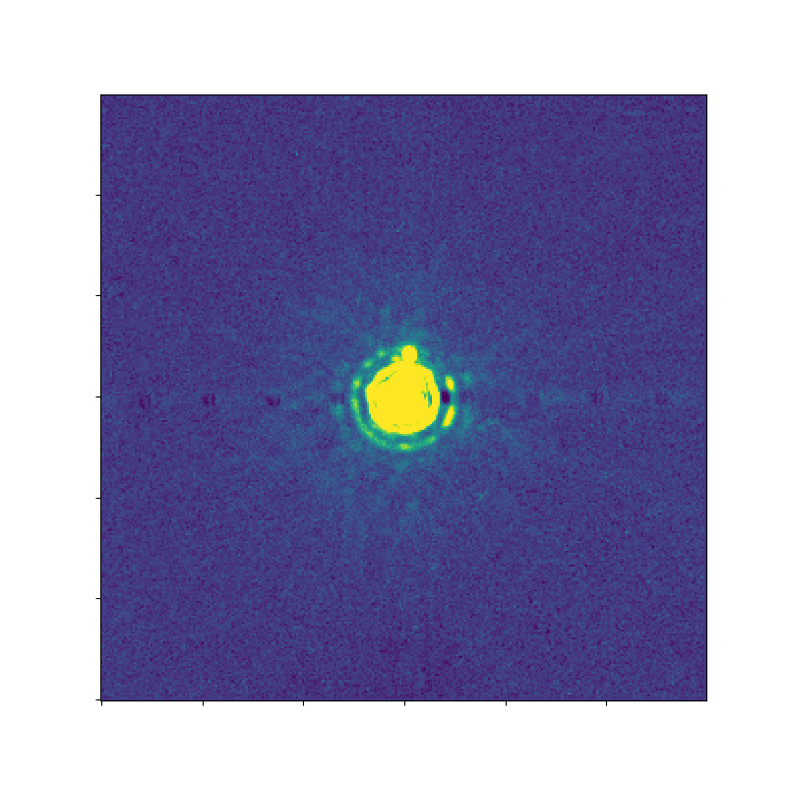
Distribution Models
Noise distributions used for exoplanet confirmation
  Confidence level (CL)
CLs are found using Gaussian distribution
Quasi-static speckle noise
  Modified Rician (MR)
Noise distribution modeling necessary to avoid false positive detections
Noise is averaged and subtracted out
Credit: J.Stone

Slide 6

Empirical Model
Create model for future exoplanet confirmation
  CL calculations
Gather annular data from LBTI database
  Two mirrors
  Timespan: 2013-2017
Distribution may or may not be Gaussian
  Verify residual distribution

Slide 7
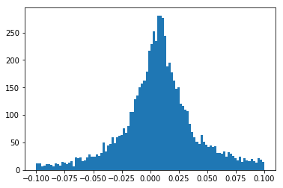
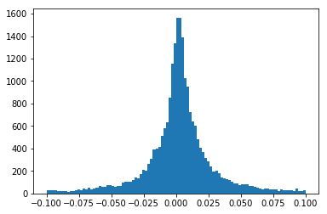
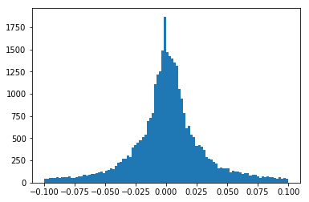
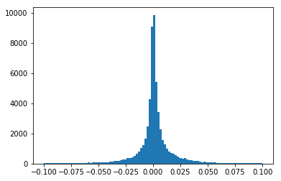
Results
R=20
R=60
Probability Density Function (PDF)
Cumulative Density Function (CDF)
  Compare empirical with Gaussian CDF
Models illustrate non-Gaussian
Can be used for future exoplanet detection
Differences in data can also yield useful information
R=100
R=150

Slide 8
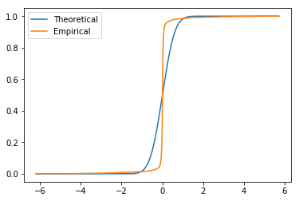
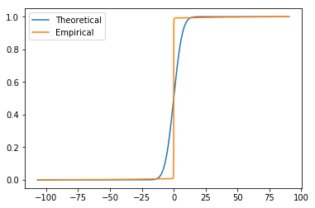
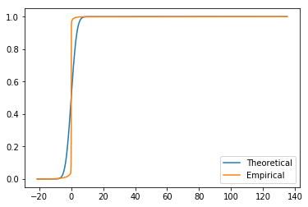
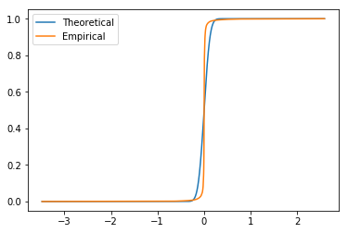
Results
Probability Density Function (PDF)
Cumulative Density Function (CDF)
  Compare empirical with Gaussian CDF
Models illustrate non-Gaussian
Can be used for future exoplanet detection
Differences in data can also yield useful information
R=20
R=60
R=100
R=150

Slide 9


Acknowledgements
I would like to thank the UA/ NASA Space Grant Consortium making this experience possible.
I would like to especially thank my mentor Dr. Jordan Stone for all of the support.

Slide 10
References
Defrère, D., Absil, O., Hinz, P., Kuhn, J., Mawet, D., Mennesson, B., … J, S. (2014). L’-band AGPM vector vortex coronagraph’s first light on LBTI/LMIRCam. Adaptive Optics Systems IV, 9148, 91483X. https://doi.org/10.1117/12.2057205
Jensen-Clem, R., Mawet, D., Gonzalez, C. A. G., Absil, O., Belikov, R., Currie, T., … Tanner, A. (2017). A New Standard for Assessing the Performance of High Contrast Imaging Systems. The Astronomical Journal, 155(1), 19. https://doi.org/10.3847/1538-3881/aa97e4
Marois, C., Lafreniere, D., Macintosh, B., & Doyon, R. (2008). Confidence Level and Sensitivity Limits in High Contrast Imaging. The Astrophysical Journal, 673(1), 647–656. https://doi.org/10.1086/523839
Mawet, D., Milli, J., Wahhaj, Z., Pelat, D., Absil, O., Delacroix, C., … Pueyo, L. (2014). Fundamental limitations of high contrast imaging set by small sample statistics. The Astrophysical Journal, 792(2), 97. https://doi.org/10.1088/0004-637X/792/2/97

